Slide 1
Chapter 11
When Can I Consider My Personal Data Secure

Slide 2
Never.
See above

Slide 3
It’s Not a Question of If
It’s a question of when
At the very, that should be everyone’s attitude
What do we do to reduce the risk?
Where are the largest risks?
How can we mitigate them?

Slide 4
Recent Data
From http://www.symantec.com/security_response/publications/threatreport.jsp
Symantec 2015 Internet Security Threat Report

Slide 5
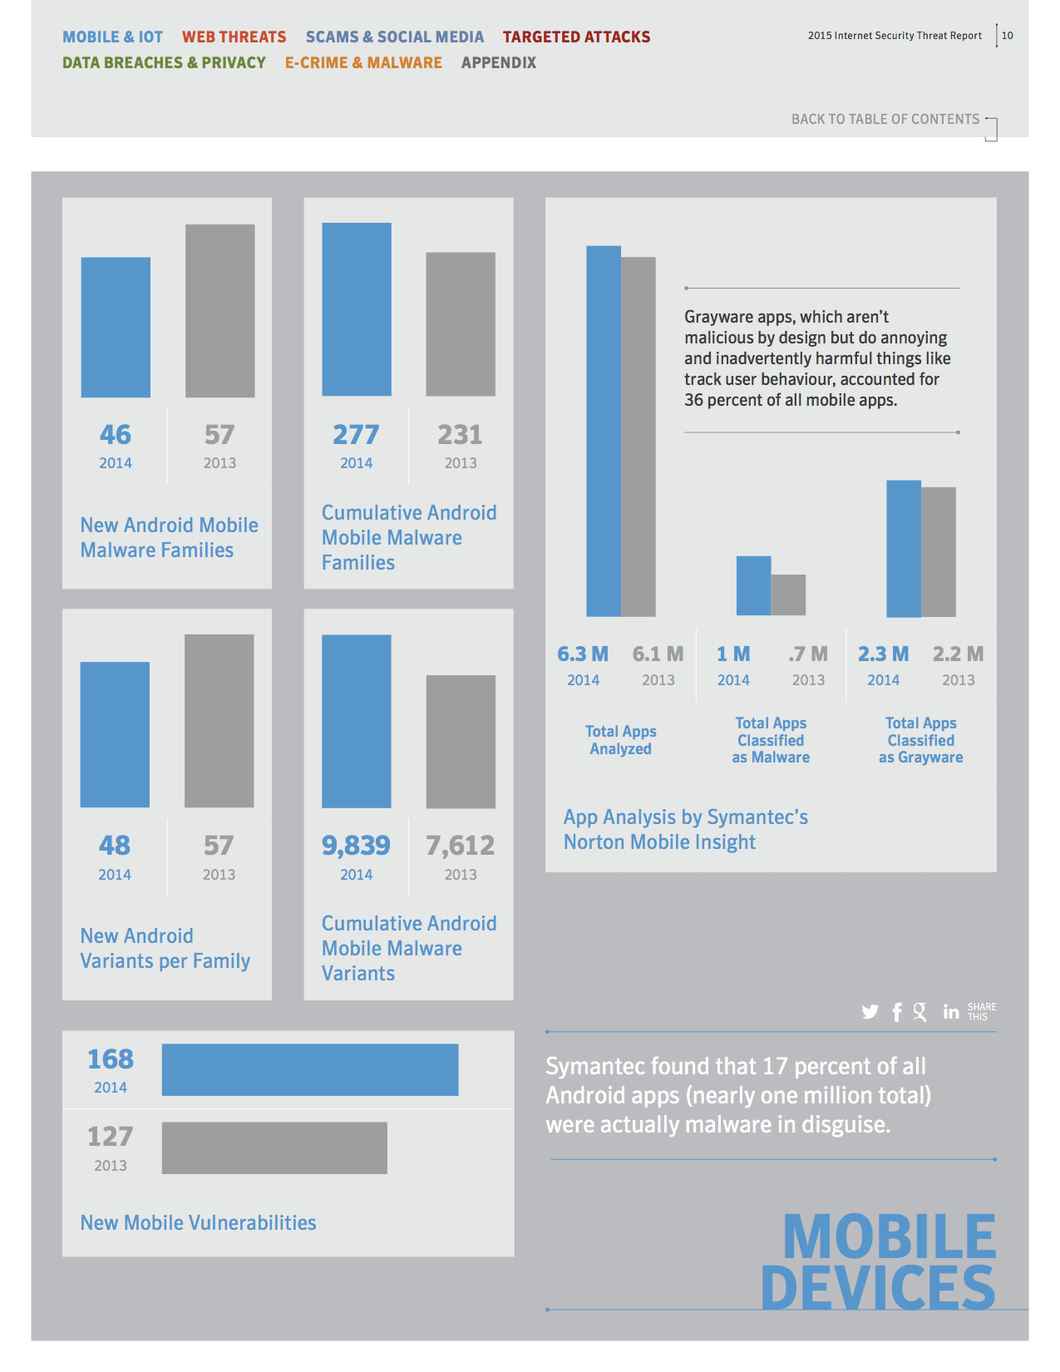

Slide 6
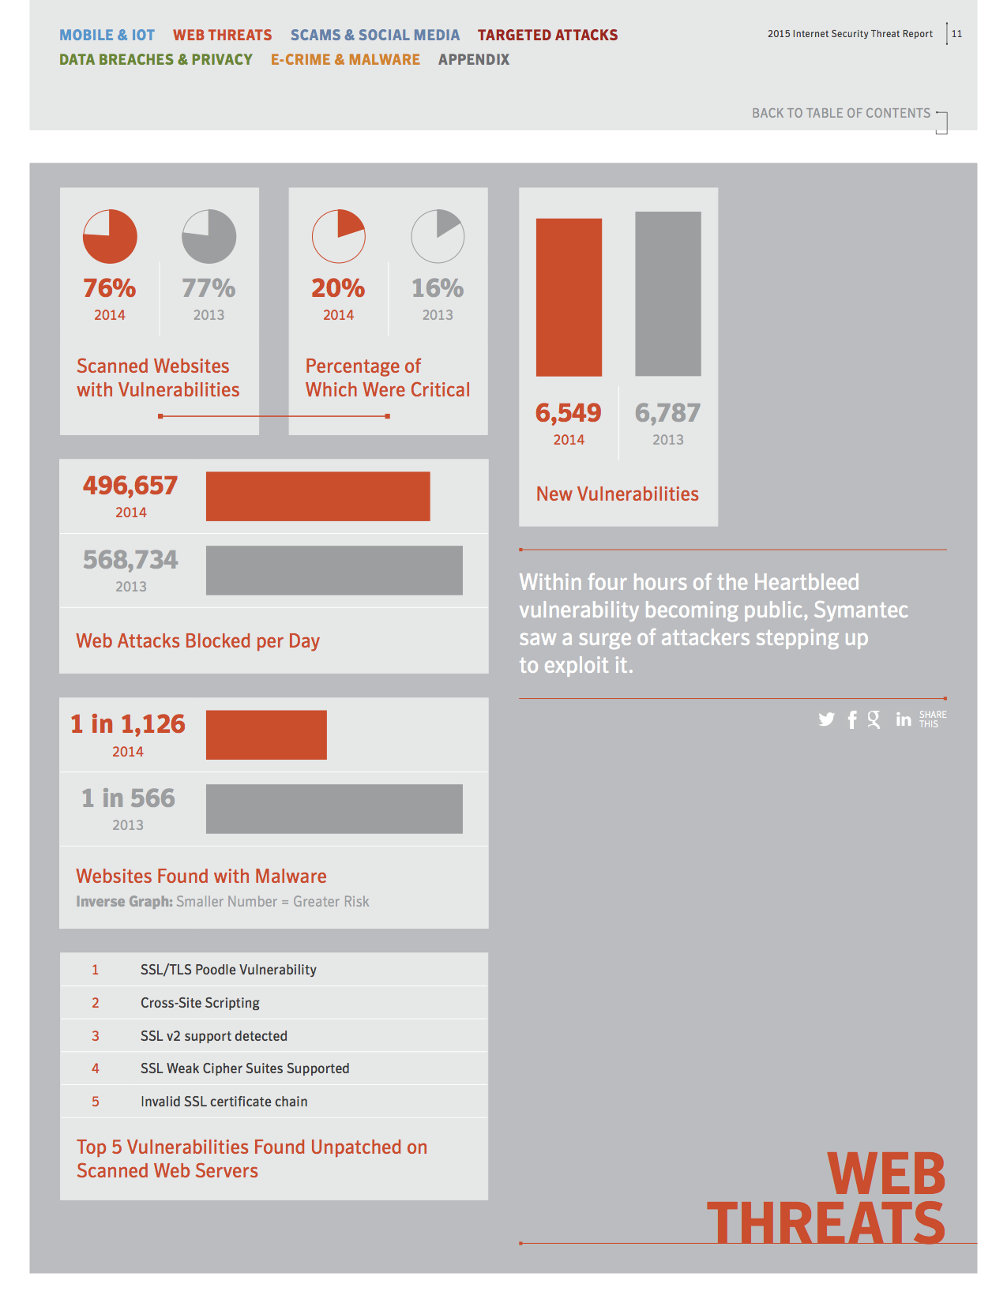

Slide 7
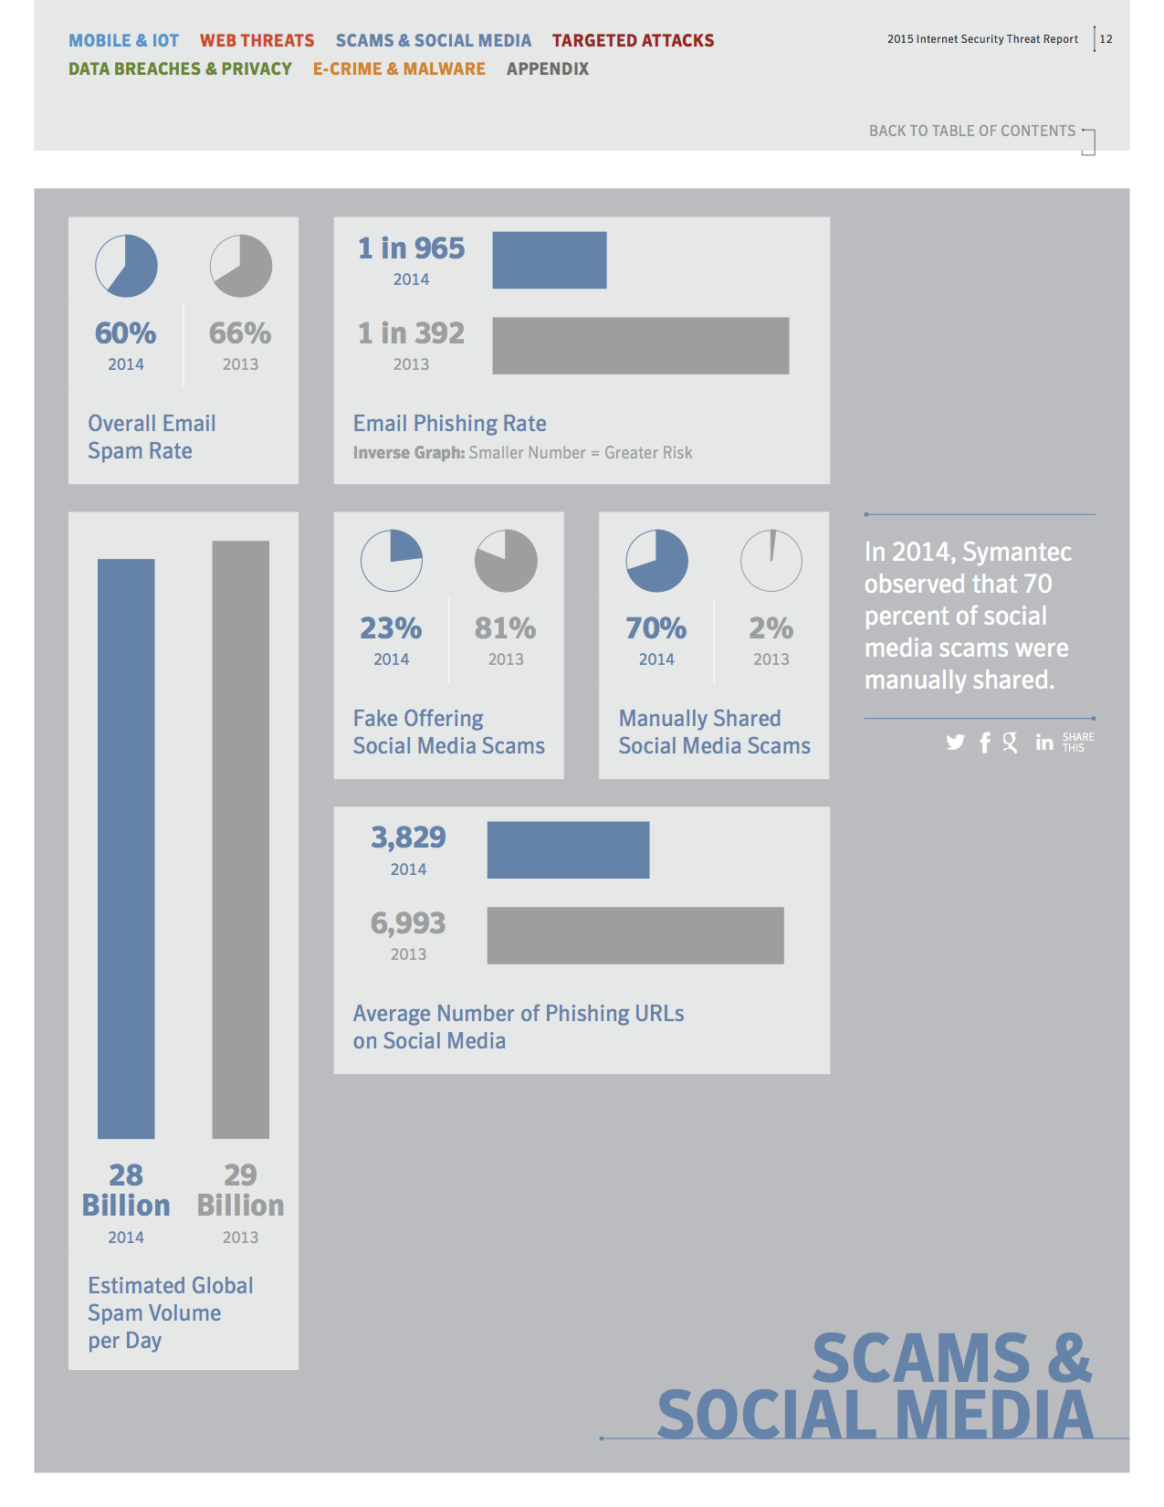

Slide 8
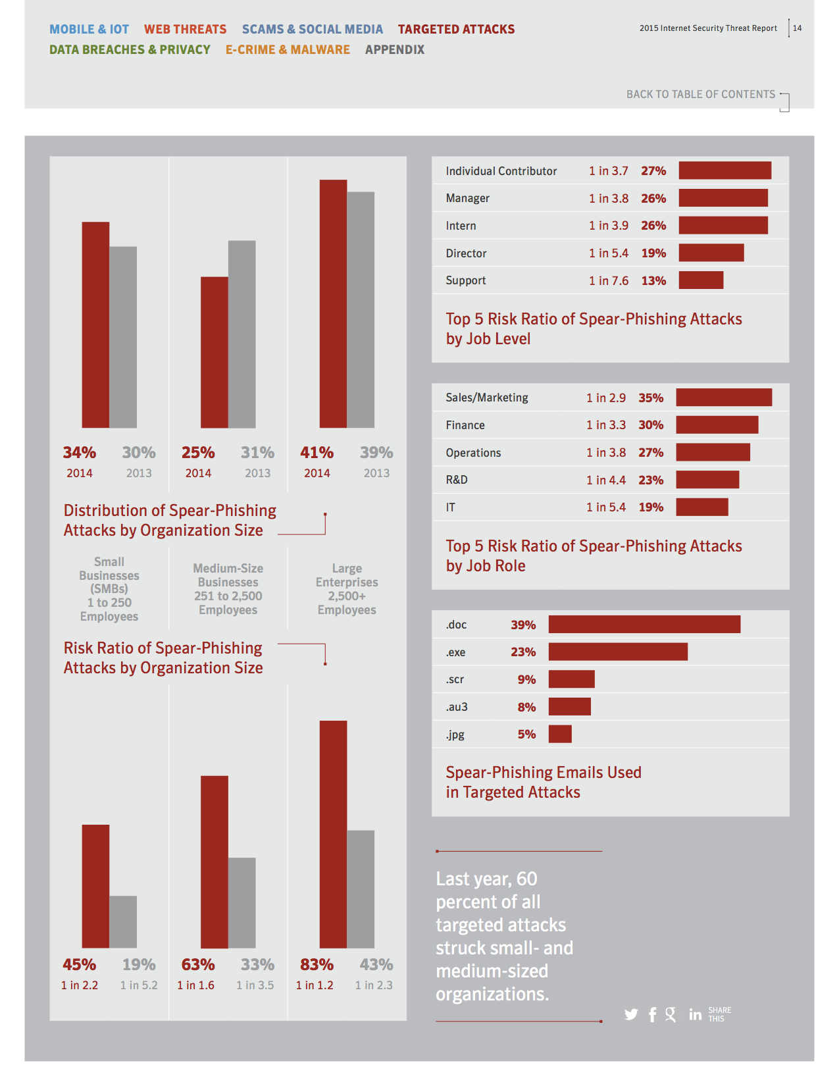

Slide 9
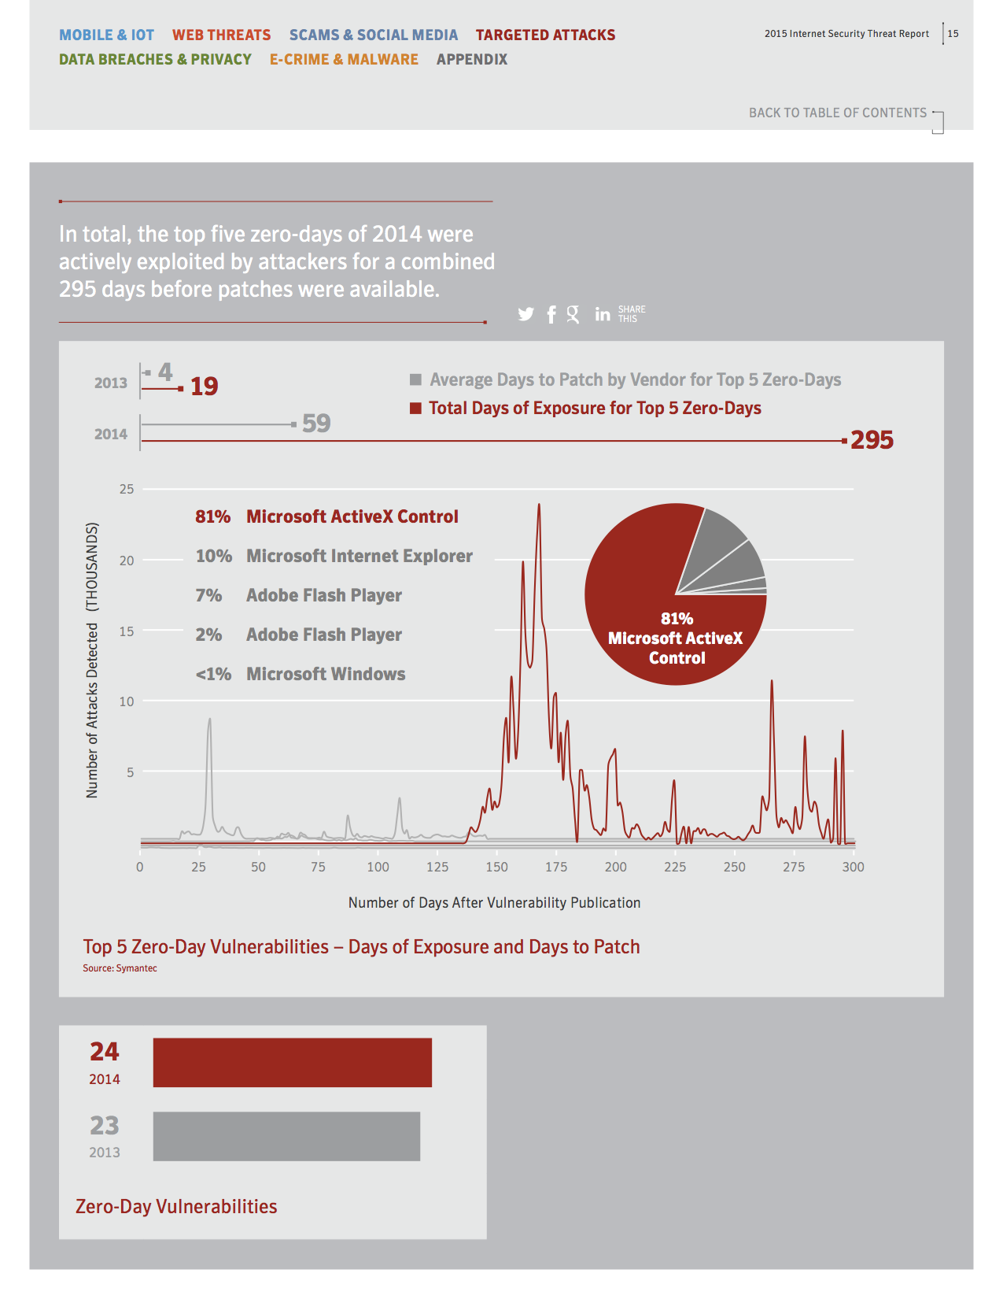

Slide 10
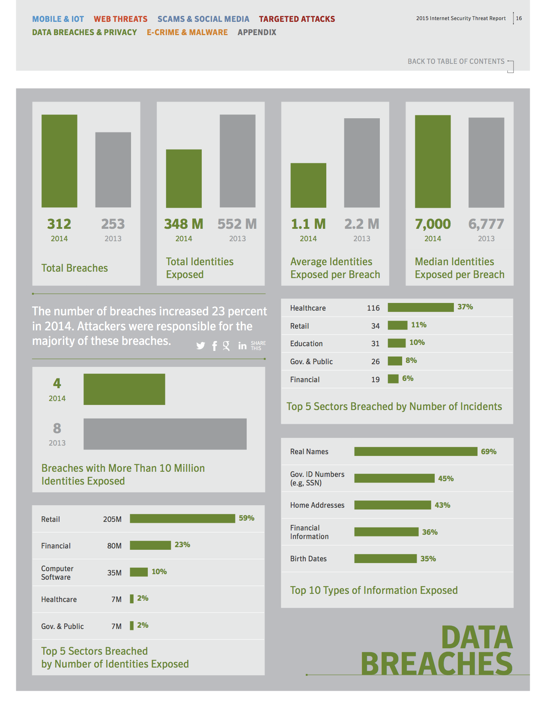

Slide 11
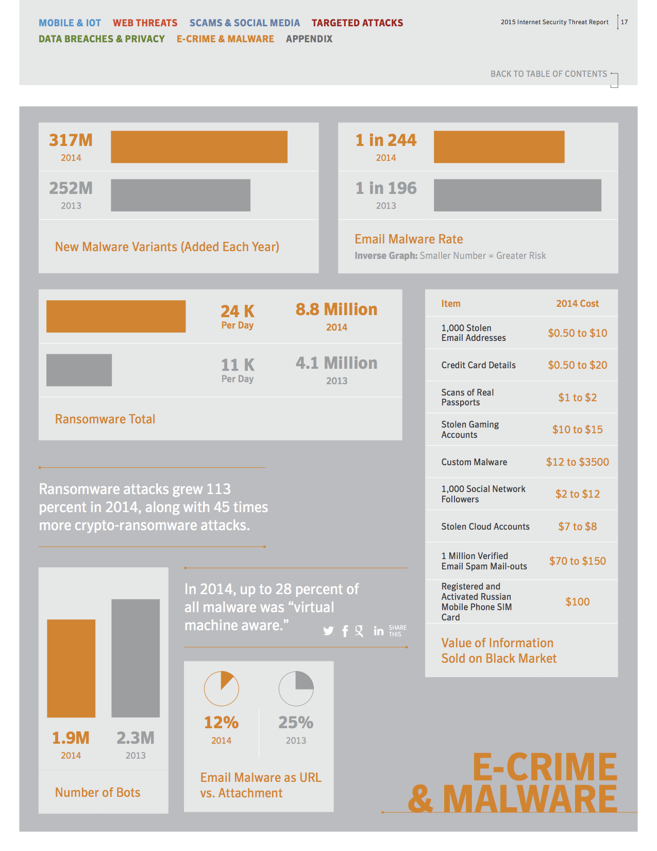

Slide 12
Data Breaches
http://www.informationisbeautiful.net/visualizations/worlds-biggest-data-breaches-hacks/

Slide 13
Factors
What you know
Passwords, PINs
What you have
Credit cards, driver’s license
What you are
Biometrics
Where you are, what time of day, etc.

Slide 14
Factors
Use multiple factors whenever possible
E.g.: SMS and password

Slide 15
Passwords
Still most popular approach
More places going two factor
Password and SMS
Password and dongle

Slide 16
Password Badness
Users reuse passwords (often have only two)
When one account is compromised, all are
Lots of work to change them all
Good ones can be easy to forget (people write them down)
When one site compromised, all passwords stolen
Financially attractive to hackers

Slide 17
What Makes a Good Password?
Length
Not what the book says
“Special” characters don’t really help
To password cracking programs there are no special characters
Up to 10 characters instantly breakable using rainbow tables
http://project-rainbowcrack.com/

Slide 18
What Makes a Good Password?
Also, lie about the recovery questions
And keep in password safe

Slide 19
Most Popular Passwords
123456
password
12345
12345678
qwerty
123456789
1234
baseball
dragon
football
1234567
monkey
letmein
abc123
111111
mustang
access
shadow
master
michael
superman
696969
123123
batman
Trustno1

Slide 20
Ashley Madison
123456
12345
password
DEFAULT
123456789
abc123
p***y
1234567
696969
ashley
f***me
football
baseball
f***you
1111111
1234567890
ashleymadison
password1
madison
a**hole

Slide 21
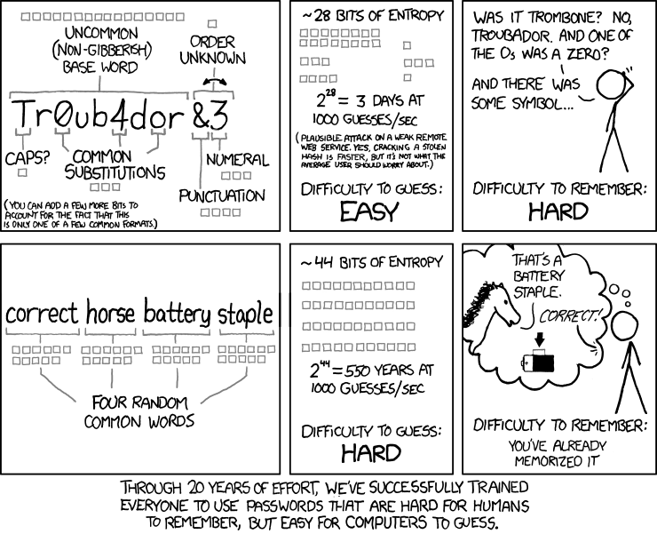
XKCD
Notes:
https://xkcd.com/936/

Slide 22
Good Password Generators
http://www.k336.org/2015/08/xkcd-style-password-generator.html
http://www.k336.org/2012/01/passwords.html

Slide 23
Password Safes
http://passwordsafe.sourceforge.net/
https://lastpass.com/
http://keepass.info/

Slide 24
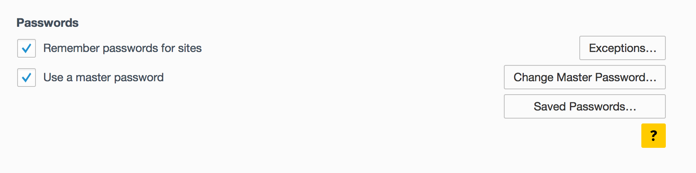
Browser Safe

Slide 25
AuthN/Z
Authentication: proving who you are
Authorization: what do you get to do?
Permissions
Multiple levels: users, editors, administrators, etc.

Slide 26
Permission Systems
Create, read, modify, execute, delete, etc.
Access Control Lists (ACLs)
Each permission mapped to each user
Windows mechanism
File permissions
User, group, others – read, write, execute
UNIX
Though most UNIXs also have ACLs

Slide 27
Backup
Critical to recovery and therefore security
Best to have backups write-only
Ransomware can lock any writable file available
Must keep media physically secure
Crashplan (www.code42.com) is a good, free approach for backing up between computers

Slide 28
Backup
Full: all the files
Incremental: those that have changed
Faster
And have history

Slide 29
Host and Network Firewalls
Have both
Only allow certain traffic in and out
Can be based on ports, applications, etc.
“Next generation” firewalls filter on content of messages

Slide 30
Encryption
Transforming easily readable to not
Caesar cipher an early example
Rotate alphabet by four
A → D, B → E, etc.
Wasn’t broken, but that may be in large part due to how few could read anyway
Called substitution cipher

Slide 31
Decryption
Easy to decipher
Can try all shifts
Letter frequencies help

Slide 32
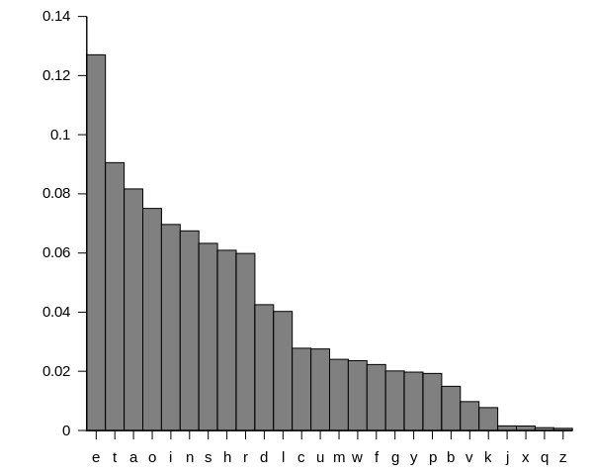
Letter Frequencies
Notes:
https://en.wikipedia.org/wiki/Letter_frequency

Slide 33
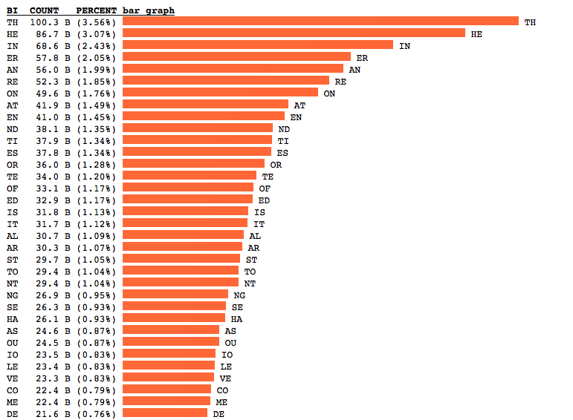
Two Letter Frequencies
Notes:
http://norvig.com/mayzner.html

Slide 34
N-Grams
1 2grams 3grams 4-grams 5-grams 6-grams 7-grams 8-grams 9-grams
e th the tion ation ations present differen different
t he and atio tions ration ational national governmen
a in ing that which tional through consider overnment
o er ion ther ction nation between position formation
i an tio with other ection ication ifferent character
n re ent ment their cation differe governme velopment
s on ati ions there lation ifferen vernment developme
r at for this ition though general overnmen evelopmen
h en her here ement presen because interest condition
l nd ter from inter tation develop importan important
d ti hat ould ional should america ormation articular
c es tha ting ratio resent however formatio particula

Slide 35
N-Grams
u or ere hich would genera eration relation represent
m te ate whic tiona dition nationa question individua
f of his ctio these ationa conside american ndividual
p ed con ence state produc onsider characte relations
g is res have natio throug ference haracter political
w it ver othe thing hrough positio articula informati
y al all ight under etween osition possible nformatio
b ar ons sion ssion betwee ization children universit
v st nce ever ectio differ fferent elopment following
k to men ical catio icatio without velopmen experienc
x nt ith they latio people ernment developm stitution
j ng ted inte about iffere vernmen evelopme xperience
q se ers ough count fferen overnme conditio education
z ha pro ance ments struct governm ondition roduction

Slide 36
More Sophisticated
Each letter uses different shift
Use random letters instead of shift
Create code book
Can be offsets into a real book
Can be specifically made for encryption
Basis of only truly unbreakable cipher: one-time pad

Slide 37
Transposition
Move character from one position to another
Scrambles message
Substitution and transposition basis of all symmetric encryption algorithms
Both side share same password/key/code book…
Known as private key systems because anyone can decrypt if have the key, therefor key must be kept private

Slide 38
Asymmetric
Problem: can we encrypt messages if both sides don’t share key
Answer: yes, with public-key cryptography
Each side generates a public and a private key
Public key is published to the world
Messages encrypted using public key
Only private key can decrypt

Slide 39
Asymmetric
Challenge: can private key be very difficult to derive from public key?
Yes, using known-difficult problems
Factoring of large composite numbers that are multiplication of two large primes
Given a total weight and a bunch of smaller weights, which smaller weights were used to create total weight (knapsack problem)

Slide 40
Asymmetric
Given two points, what elliptic curve fits them?
Each of these are “easy” to compute one way, but not the other
Akin to squaring a number and taking the square root of the number

Slide 41
Example
If message is n, encode via c = n^{e} mod m
c easily calculated
e and m published
Decrypt via n = c^{d} mod m
If d is difficult to compute, decryption only possible if one has d

Slide 42
RSA
“Start with two large prime numbers, p and q. Then let m=pq and let L = lcm (p−1, q−1), the least common multiple of p−1 and q−1. Then d and e may be computed by taking any solution to the equation de = 1 (mod L). Although such computations are easy once p and q are known, the discovery of p and q is difficult given only n, because the factoring of very large integers can require a large amount of time”

Slide 43
HTTPS
The handshake begins when a client connects to a TLS-enabled server requesting a secure connection and presents a list of supported cipher suites (ciphers and hash functions).
From this list, the server picks a cipher and hash function that it also supports and notifies the client of the decision.
The server usually then sends back its identification in the form of a digital certificate. The certificate usually contains the server name, the trusted certificate authority (CA) and the server's public encryption key.
Notes:
https://en.wikipedia.org/wiki/Transport_Layer_Security

Slide 44
HTTPS
The client may contact the server that issued the certificate (the trusted CA as above) and confirm the validity of the certificate before proceeding.
In order to generate the session keys used for the secure connection, the client encrypts a random number with the server's public key and sends the result to the server. Only the server should be able to decrypt it, with its private key.
From the random number, both parties generate a 'master secret' and then negotiate a session key for encryption and decryption.

Slide 45
Certificate Authorities
How do we know the HTTPS servers we are connecting to are who they claim to be?
There are a number of third-party certificate authorities that vouch for authenticity of certificate
Verisign a major provider

Slide 46
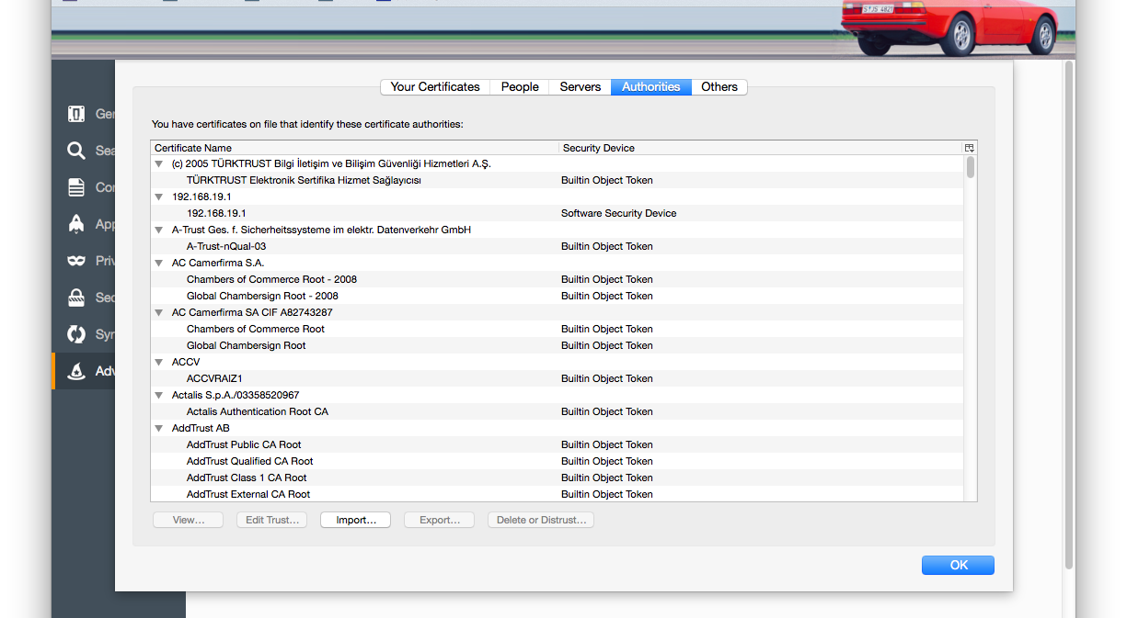

Slide 47
Firefox Trusted Root Certificates
205
Including 19 prohibited

Slide 48
What Else Can Go Wrong?
Anything you can do, so can someone else
Keyboard sniffer
Can be either software or hardware
Watches everything you type and emails results
http://hackerwarehouse.com/product/keygrabber/

Slide 49
What Else Can Go Wrong?
Network sniffer
Always use secure protocols
Trojan horse
Something that appears to be a regular program
Always be very care downloading programs
Pay attention to “side-along” downloads

Slide 50
What Else Can Go Wrong?
Virus
Uses host to transmit
Typically email or document
Be careful with document macros
Worm
Self propagating

Slide 51
Zombies and Botnets
Any of the above malware in control of your computer
Communicate with controller networks
Encrypted and self-upgrading
Sold for personal information and as attack vectors
Used for Distributed Denial of Service (DDoS) attacks and many other things

Slide 52

Phish

Slide 53
Phishing
Targeted email scams
Typically trying to get users to click on link that leads to malware
http://www.antiphishing.org/

Slide 54
Detection
Signatures
Difficult because viruses change form by themselves
Difficult because there is a lag between finding, writing signature, distribution of signature
Moving toward behavioral-based

Slide 55
What To Do
Keep OS and programs updated
Use AV
Be very careful downloading
Turn off Java, Flash, etc., in your browser
Don’t open email attachments even from people you know
They might be infected
Check with them that they sent it

Slide 56
What To Do
Use firewalls
Don’t allow macros to run

Slide 57
ATMs
Skimming has been on the rise
Cover the keypad as you type

